Slide 1

Step 1: Open up a Google Chrome browser.

Slide 2
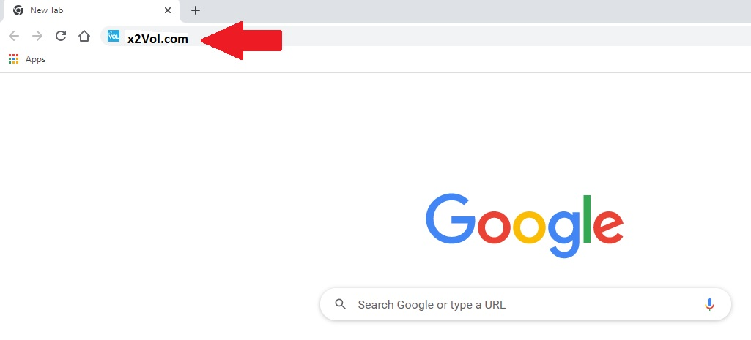
Step 2: Type “x2Vol.com” in the address bar and press “Enter”

Slide 3

Step 3: On the x2Vol website, click on “Join”.

Slide 4
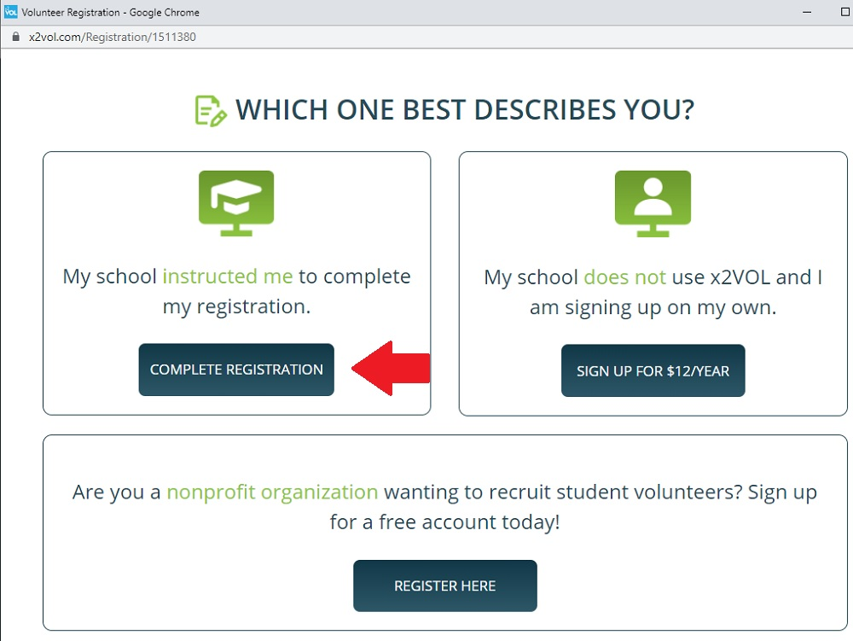
Step 4: In the box that says, “My school instructed me to complete my registration.”, click on the “Complete Registration” button.

Slide 5
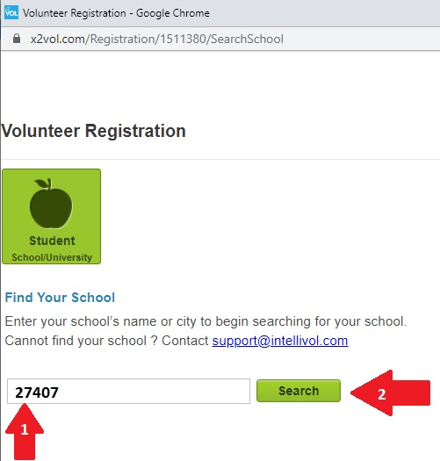
Step 5: On the Volunteer Registration page, type “27407” in the text box and then click the “Search” button.

Slide 6
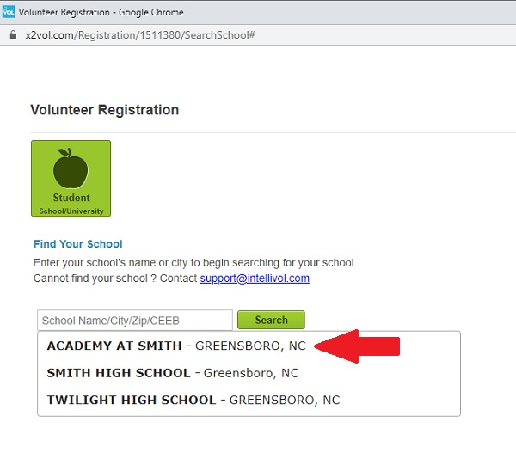
Step 6: From the drop-down list, choose “Academy at Smith”.

Slide 7
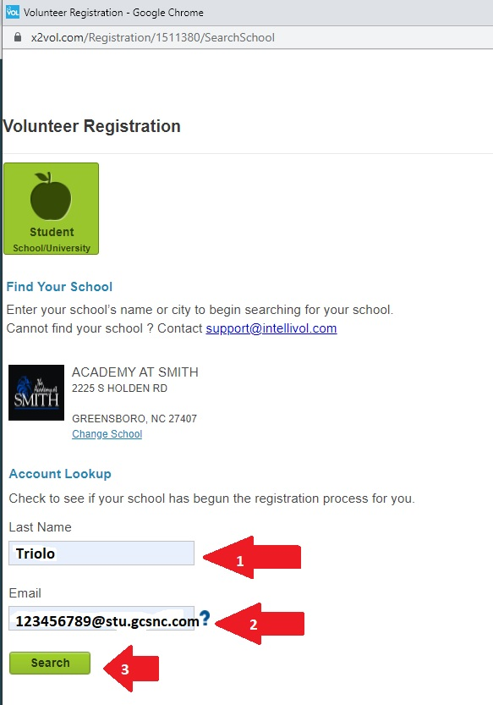
Step 7: 1) In the “Last Name” box, type your last name.
2) In the “Email” box, type your school email address.
3) Click on the “Search” button

Slide 8
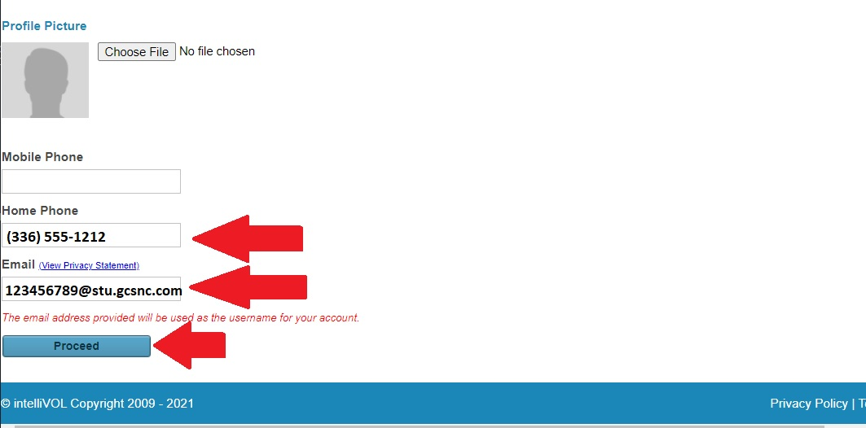
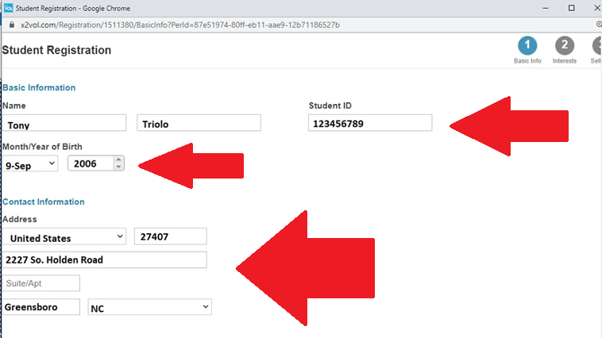
Step 8: Fill in all required boxes, then click the “Proceed” button.

Slide 9
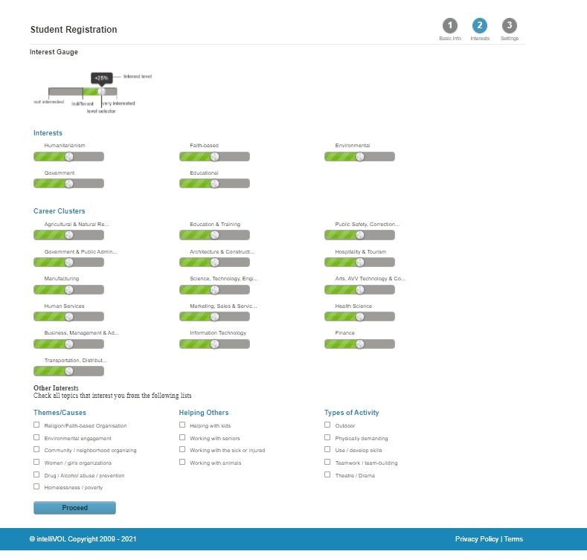
Step 9: Select your interests, if desired.

Slide 10
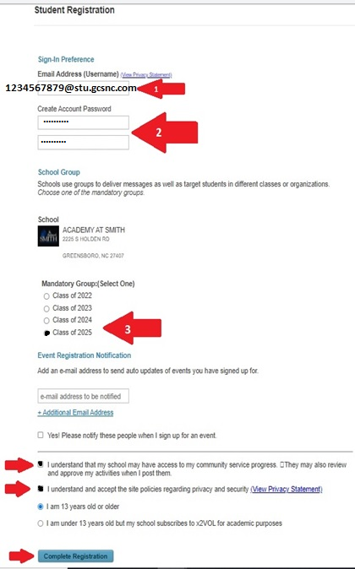
Step 10: 1) Check your email address.
2) Set your password to your birthdate
(MMDDYYYY).
3) Choose your Graduating Class.
4) Click on the Check Boxes shown.
5) Click the “Complete Registration” button.

Slide 11
Voila
You have created your x2vol Account!
Congratulations!

